Slide 1


Lecture 17
Produced by Dr. Worldwide
Welcome to the 305
~
~

Slide 2

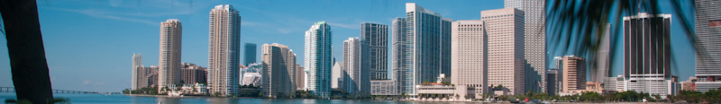
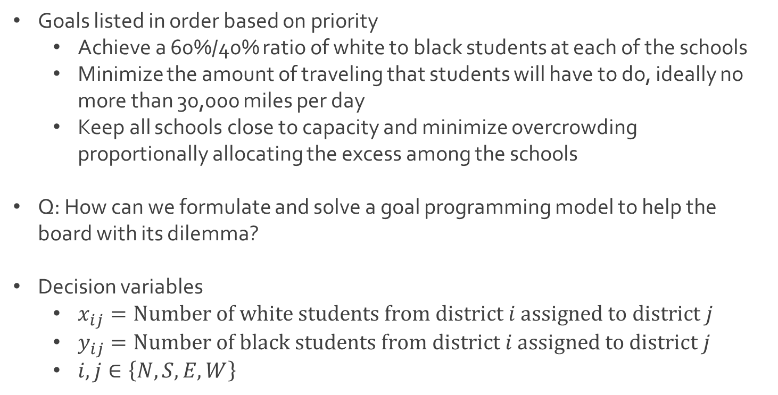
Ex: Oakdale School Busing
Goals listed in order based on priority
Achieve a 60%/40% ratio of white to black students at each of the schools
Minimize the amount of traveling that students will have to do, ideally no more than 30,000 miles per day
Keep all schools close to capacity and minimize overcrowding proportionally allocating the excess among the schools
Q: How can we formulate and solve a goal programming model to help the board with its dilemma?
Decision variables
$x_{ij}=Number of white students from district i assigned to district j$
$y_{ij}=Number of black students from district i assigned to district j$
$i,j∈\left\{N,S,E,W\right\}$

Slide 3
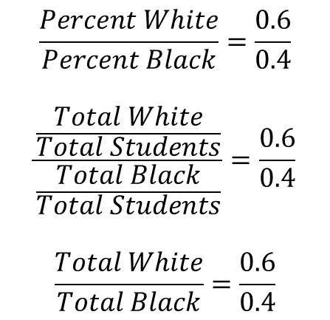
Ex: Oakdale School Busing
Goal 1: Achieve racial balance in all 4 schools
Consider perfect balance for North High School
$$\frac{Percent White}{Percent Black}=\frac{0.6}{0.4}$$
$$\frac{\frac{Total White}{Total Students}}{\frac{Total Black}{Total Students}}=\frac{0.6}{0.4}$$
$$\frac{Total White}{Total Black}=\frac{0.6}{0.4}$$
$$0.4\left(Total White\right)−0.6\left(Total Black\right)=0$$
$$0.4\left(x_{NN}+x_{SN}+x_{EN}+x_{WN}\right)−0.6\left(y_{NN}+y_{SN}+y_{EN}+y_{WN}\right)=0$$

Slide 4
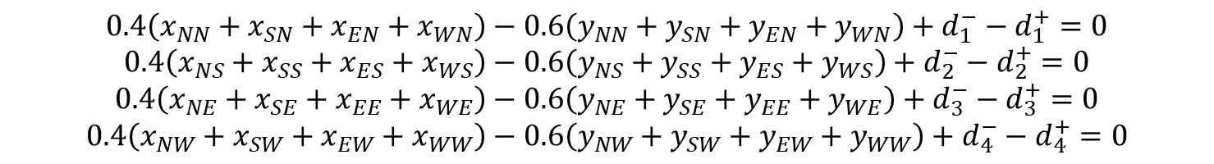
Ex: Oakdale School Busing
Goal 1: Achieve racial balance in all 4 schools
Adding deviational variables for North High School
Consider constraints for all schools in the county
To accomplish our goal we want all of these deviational variables to be as small as possible
First priority objective
$$0.4\left(x_{NN}+x_{SN}+x_{EN}+x_{WN}\right)−0.6\left(y_{NN}+y_{SN}+y_{EN}+y_{WN}\right)+d_{1}^{−}−d_{1}^{+}=0$$
$$0.4\left(x_{NN}+x_{SN}+x_{EN}+x_{WN}\right)−0.6\left(y_{NN}+y_{SN}+y_{EN}+y_{WN}\right)+d_{1}^{−}−d_{1}^{+}=0$$
$$0.4\left(x_{NS}+x_{SS}+x_{ES}+x_{WS}\right)−0.6\left(y_{NS}+y_{SS}+y_{ES}+y_{WS}\right)+d_{2}^{−}−d_{2}^{+}=0$$
$$0.4\left(x_{NE}+x_{SE}+x_{EE}+x_{WE}\right)−0.6\left(y_{NE}+y_{SE}+y_{EE}+y_{WE}\right)+d_{3}^{−}−d_{3}^{+}=0$$
$$0.4\left(x_{NW}+x_{SW}+x_{EW}+x_{WW}\right)−0.6\left(y_{NW}+y_{SW}+y_{EW}+y_{WW}\right)+d_{4}^{−}−d_{4}^{+}=0$$
$$Minimize P_{1}(d_{1}^{−}+d_{1}^{+}+d_{2}^{−}+d_{2}^{+}+d_{3}^{−}+d_{3}^{+}+d_{4}^{−}+d_{4}^{+})$$

Slide 5
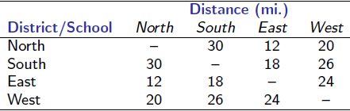
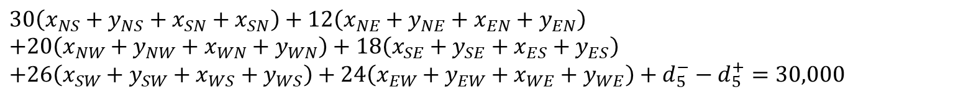
Ex: Oakdale School Busing
Goal 2: Minimize total travel to not much more than 30,000 miles
Recall the following table
Formulation for constraint based on total miles
Updated objective function for second priority
$$30\left(x_{NS}+y_{NS}+x_{SN}+x_{SN}\right)+12\left(x_{NE}+y_{NE}+x_{EN}+y_{EN}\right)$$
$$+20\left(x_{NW}+y_{NW}+x_{WN}+y_{WN}\right)+18\left(x_{SE}+y_{SE}+x_{ES}+y_{ES}\right)$$
$$+26\left(x_{SW}+y_{SW}+x_{WS}+y_{WS}\right)+24\left(x_{EW}+y_{EW}+x_{WE}+y_{WE}\right)+d_{5}^{−}−d_{5}^{+}=30,000$$
$$Minimize P_{1}\left(d_{1}^{−}+d_{1}^{+}+d_{2}^{−}+d_{2}^{+}+d_{3}^{−}+d_{3}^{+}+d_{4}^{−}+d_{4}^{+}\right), P_{2}(d_{5}^{+})$$

Slide 6
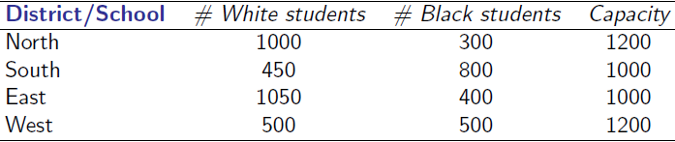
Ex: Oakdale School Busing
Goal 3: Minimize overcrowding at each of the 4 schools, proportionally allocating the excess among the schools
Recall the following table
Recall that there are 5,000 total students for capacity of 4,400
The excess of 600 students needs to be split between the schools
Q: How can we handle this proportionally?

Slide 7

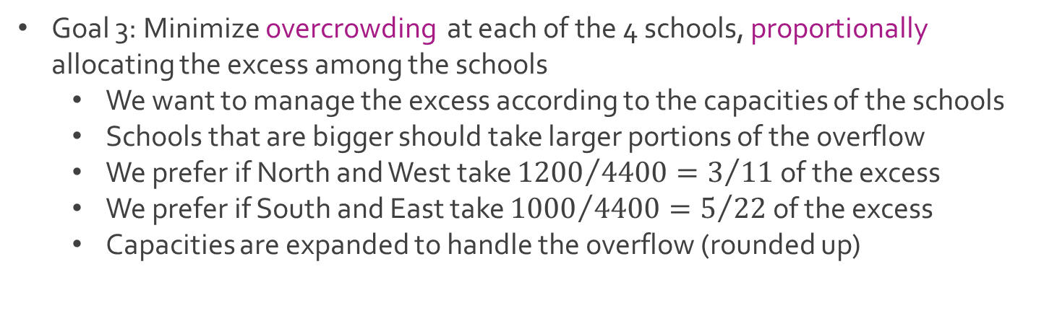
Ex: Oakdale School Busing
Goal 3: Minimize overcrowding at each of the 4 schools, proportionally allocating the excess among the schools
We want to manage the excess according to the capacities of the schools
Schools that are bigger should take larger portions of the overflow
We prefer if North and West take ${1200}/{4400}=3/{11}$ of the excess
We prefer if South and East take ${1000}/{4400}=5/{22}$ of the excess
Capacities are expanded to handle the overflow (rounded up)
$$1200+\frac{3}{11}\left(600\right)=1363.636363≈1364$$

Slide 8

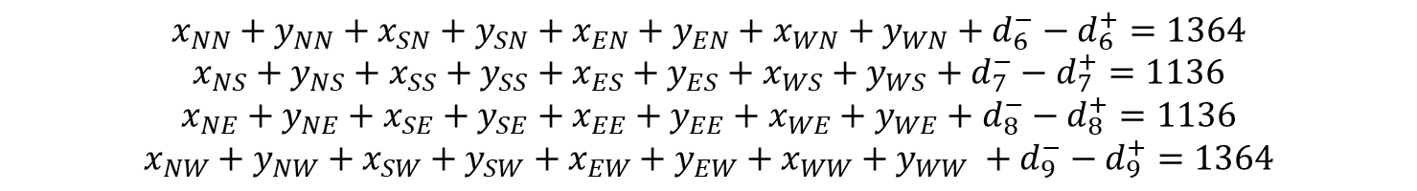
Ex: Oakdale School Busing
Goal 3: Minimize overcrowding at each of the 4 schools, proportionally allocating the excess among the schools
Constraints with deviational variables
Updated objective function for third priority
$$x_{NN}+y_{NN}+x_{SN}+y_{SN}+x_{EN}+y_{EN}+x_{WN}+y_{WN}+d_{6}^{−}−d_{6}^{+}=1364$$
$$x_{NS}+y_{NS}+x_{SS}+y_{SS}+x_{ES}+y_{ES}+x_{WS}+y_{WS}+d_{7}^{−}−d_{7}^{+}=1136$$
$$x_{NE}+y_{NE}+x_{SE}+y_{SE}+x_{EE}+y_{EE}+x_{WE}+y_{WE}+d_{8}^{−}−d_{8}^{+}=1136$$
$$x_{NW}+y_{NW}+x_{SW}+y_{SW}+x_{EW}+y_{EW}+x_{WW}+y_{WW} +d_{9}^{−}−d_{9}^{+}=1364$$
$$Minimize P_{1}\left(d_{1}^{−}+d_{1}^{+}+d_{2}^{−}+d_{2}^{+}+d_{3}^{−}+d_{3}^{+}+d_{4}^{−}+d_{4}^{+}\right),$$ $P_{2}\left(d_{5}^{+}\right),$
$P_{3}\left(d_{6}^{−}+d_{6}^{+}+d_{7}^{−}+d_{7}^{+}+d_{8}^{−}+d_{8}^{+}+d_{9}^{−}+d_{9}^{+}\right)$

Slide 9

Ex: Oakdale School Busing
Additional constraints
We cannot bus more students than what is currently available at each school
List of constraints
$$x_{NN}+x_{NS}+x_{NE}+x_{NW}=1000$$
$$y_{NN}+y_{NS}+y_{NE}+y_{NW}=300$$
$$x_{SN}+x_{SS}+x_{SE}+x_{SW}=450$$
$$y_{SN}+y_{SS}+y_{SE}+y_{SW}=800$$
$$x_{EN}+x_{ES}+x_{EE}+x_{EW}=1050$$
$$y_{EN}+y_{ES}+y_{EE}+y_{EW}=400$$
$$x_{WN}+x_{WS}+x_{WE}+x_{WW}=500$$
$$y_{WN}+y_{WS}+y_{WE}+y_{WW}=500$$

Slide 10
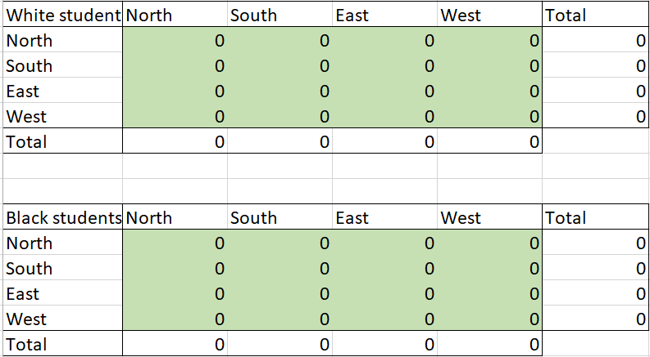
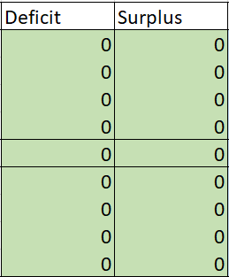

Ex: Oakdale School Busing
Additional integer constraints
Download Oakdale-1.xlsx from link Sheet 1 on course website
Tab called Priority 1
Matrices of decision variables
$$x_{ij}∈\{0,1,⋯\}$$
$$y_{ij}∈\{0,1,⋯\}$$

Slide 11
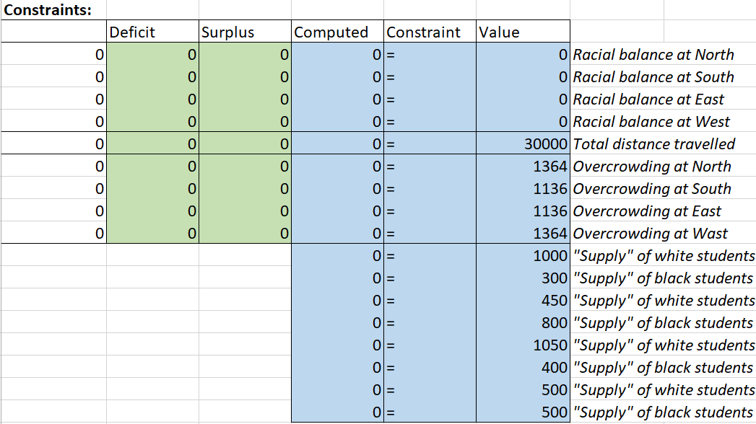
Ex: Oakdale School Busing
Tab called Priority 1
Notice all the different constraints and inspect formulas

Slide 12

Ex: Oakdale School Busing
Tab called Priority 1
First objective function
Observe formula for objective function
Q: What is “B20:C23” referring to and what is “SUM” doing?
Use Excel solver to find the optimal solution
$$Minimize{ d}_{1}^{−}+d_{1}^{+}+d_{2}^{−}+d_{2}^{+}+d_{3}^{−}+d_{3}^{+}+d_{4}^{−}+d_{4}^{+}$$
=SUM(B20:C23)

Slide 13
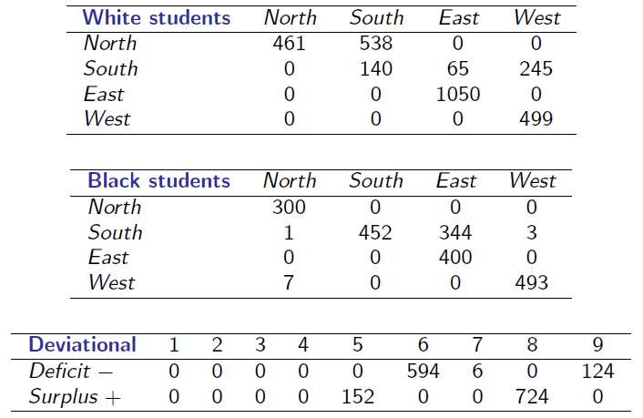
Ex: Oakdale School Busing
Tab called Priority 1
Optimal solution

Slide 14

Ex: Oakdale School Busing
Tab called Priority 2
Notice the additional constraint and inspect formula
Second objective function
Observe formula for objective function
Use Excel solver to find optimal solution
$$Minimize{ d}_{5}^{+}$$
=SUM(C24)

Slide 15
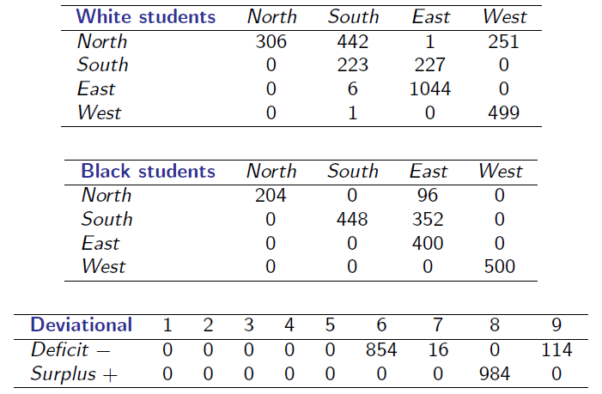
Ex: Oakdale School Busing
Tab called Priority 2
Optimal solution

Slide 16


Ex: Oakdale School Busing
Tab called Priority 3
Notice the additional constraint
Second objective function
Formula for this objective similar to first objective
Use Excel solver to find optimal solution
$$Minimize{ d}_{6}^{−}+d_{6}^{+}+d_{7}^{−}+d_{7}^{+}+d_{8}^{−}+d_{8}^{+}+d_{9}^{−}+d_{9}^{+}$$
=SUM(C24)

Slide 17
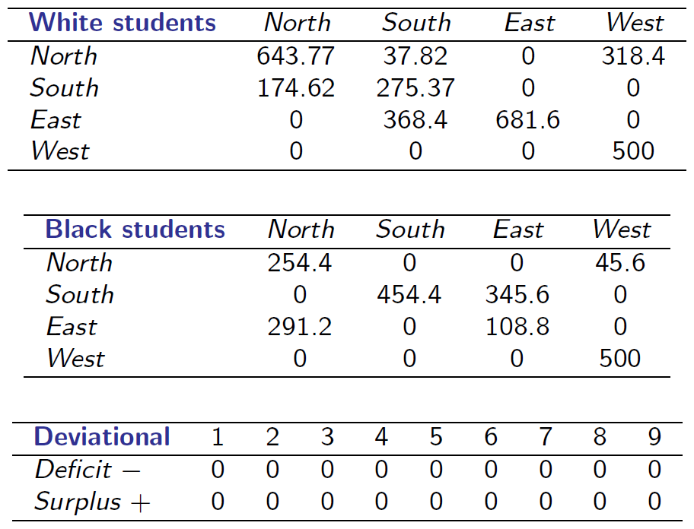
Ex: Oakdale School Busing
Tab called Priority 3
Optimal solution
Q: What is the problem with the optimal solution?

Slide 18
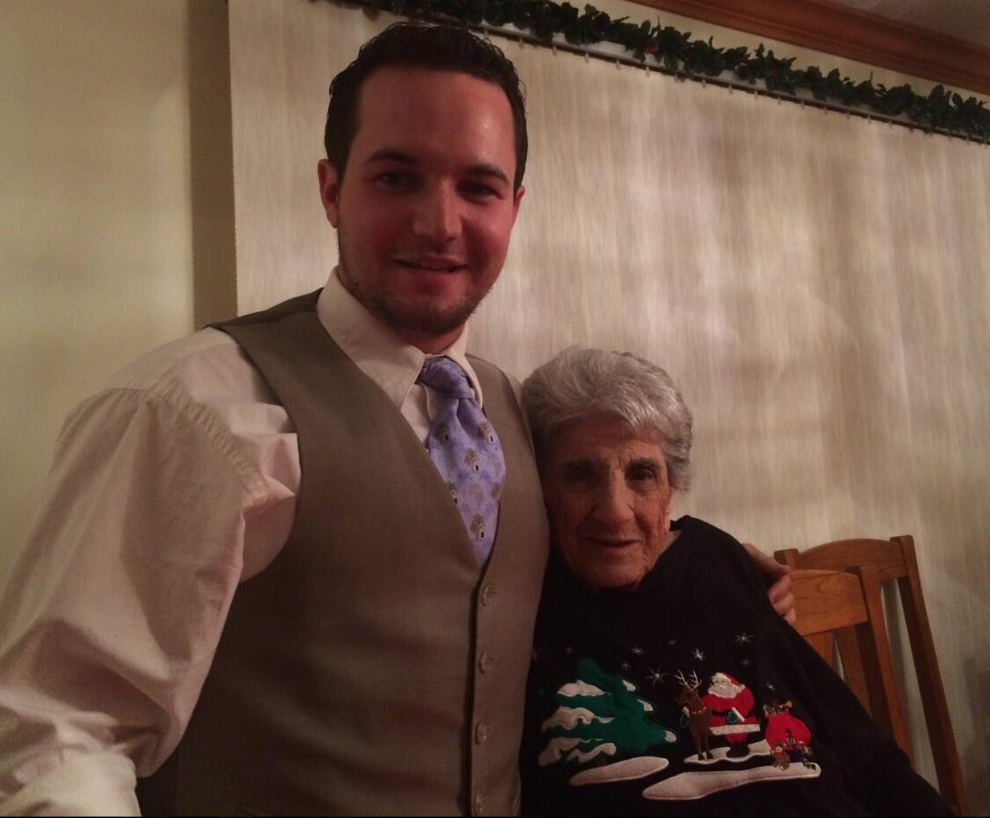
Ex: Oakdale School Busing
Tab called Priority 3
Q: What do you mean you cannot bus half a person?
Try to add integer constraints and see what happens

Slide 19




The End
Dale

